Slide 1

21MAT204 Mathematics for intelligent systems-5
By
Team-06

Slide 2
Team Members
Menta Sai Akshay[ CB.EN.U4AIE20040]
Rachure Charith Sai [ CB.EN.U4AIE20055]
Sajja Bala Karthikeya [ CB.EN.U4AIE20065]
Penaka Vishnu Reddy [ CB.EN.U4AIE20048]
D Rohith [ CB.EN.U4AIE20060]

Slide 3

Temperature forecasting using Dynamic Mode Decomposition

Slide 4
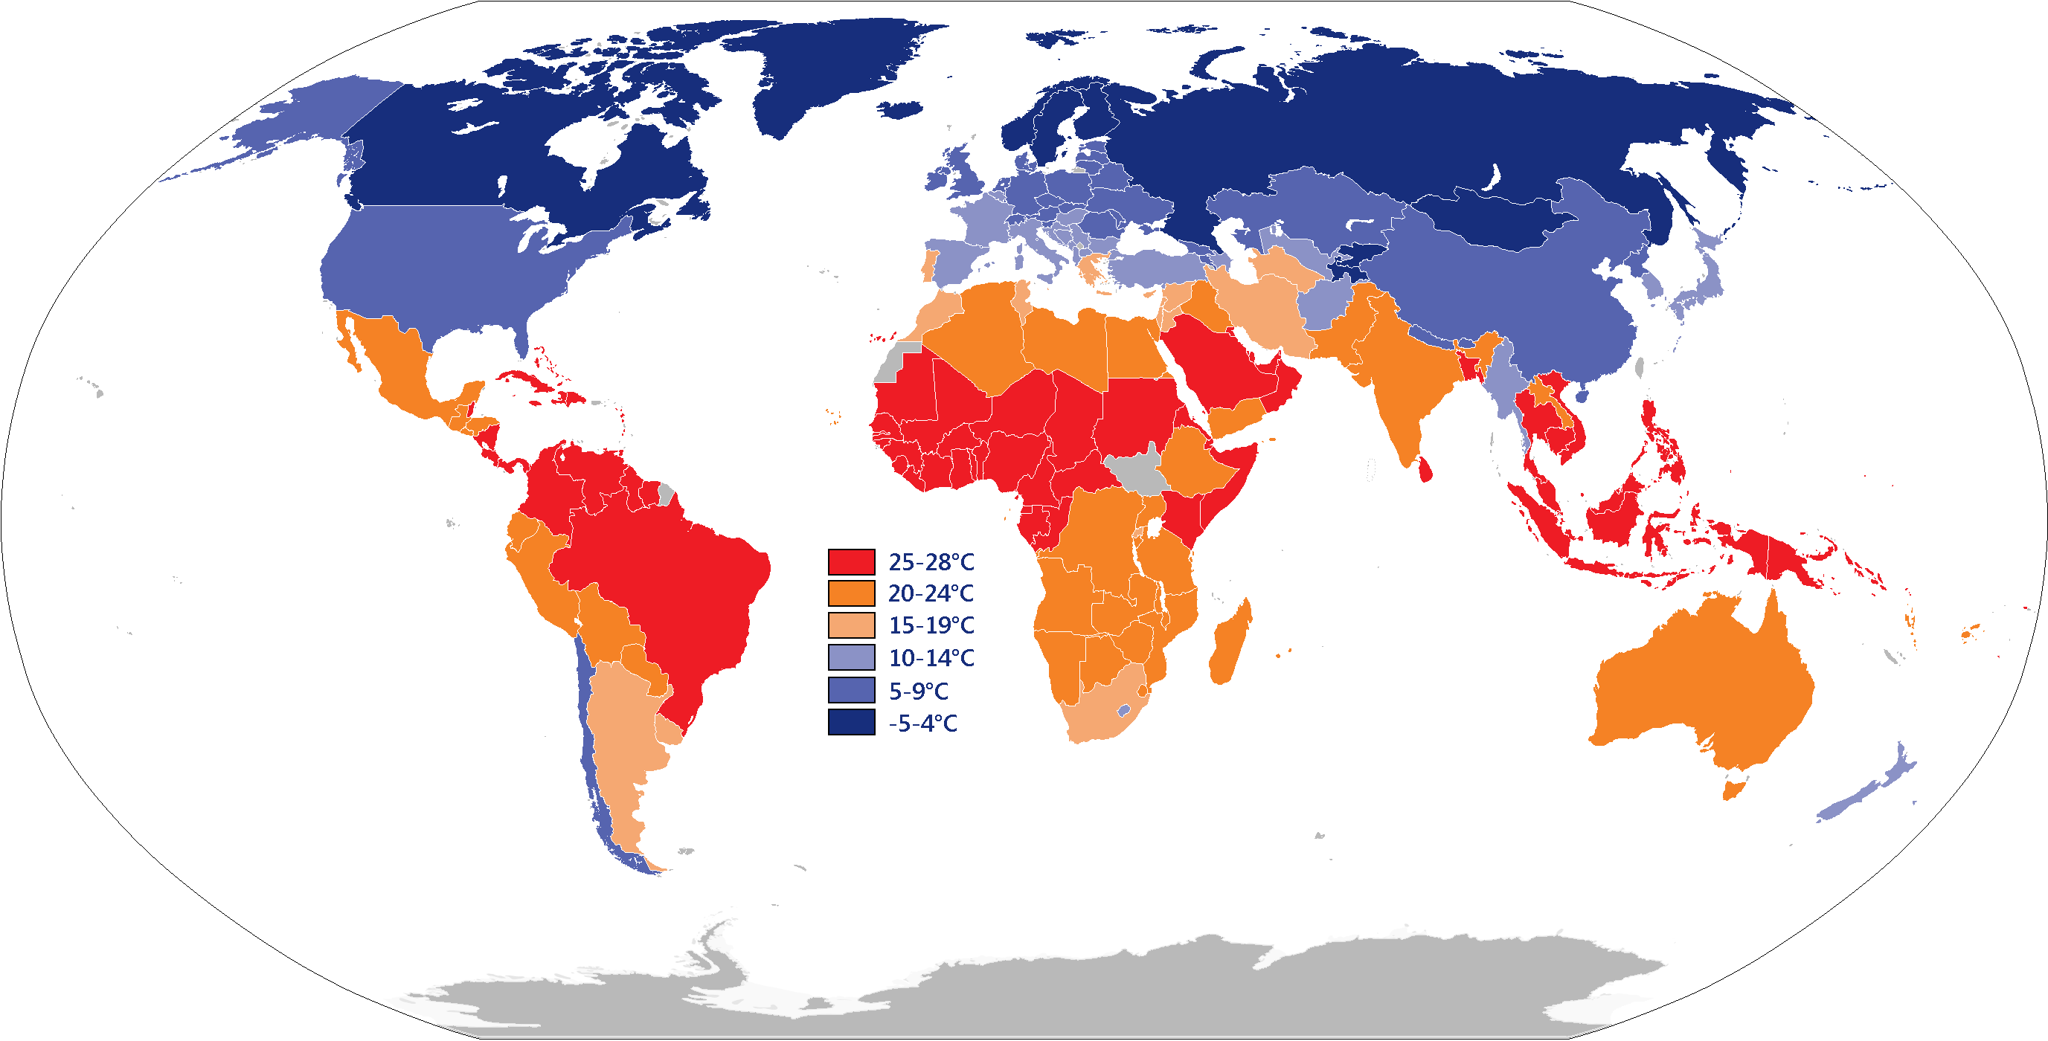
Data Description

Slide 5

NOAA GSOD
NOAA's Global Surface Summary of the Day (GSOD) is a dataset that contains daily weather observations from thousands of weather stations around the world.
The dataset includes a wide range of meteorological variables such as temperature, precipitation, wind speed, and pressure, among others.
The data is collected by the National Weather Service (NWS), the National Oceanic and Atmospheric Administration (NOAA), and other organizations, and is made available to the public through the National Centers for Environmental Information (NCEI).

Slide 6
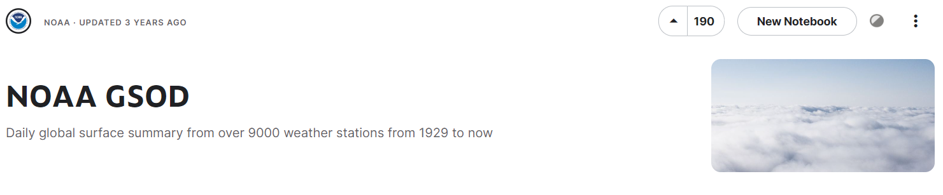
Global Surface Summary of the Day is derived from The Integrated Surface Hourly (ISH) dataset. The ISH dataset includes global data obtained from the USAF Climatology Center, located in the Federal Climate Complex with NCDC. The latest daily summary data are normally available 1-2 days after the date-time of the observations used in the daily summaries.

Slide 7
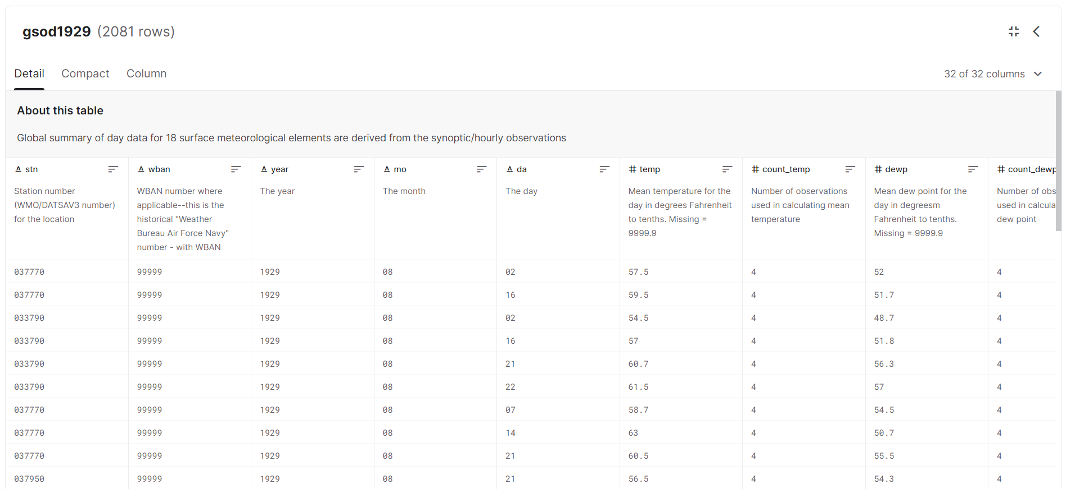
Data Example

Slide 8
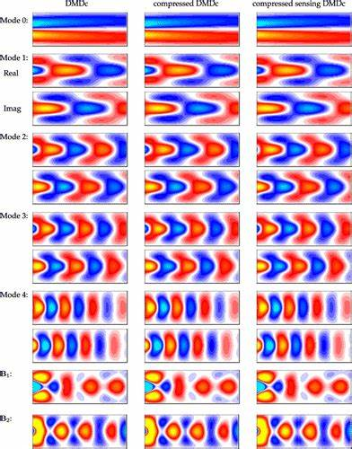
Why DMD?

Slide 9
Additionally, DMD can be used to extract the dominant modes of variability in the data, which can be used to create accurate forecasts. In contrast, traditional machine learning algorithms may not perform as well on nonlinear and non-stationary data, and may not be able to extract the underlying patterns as effectively as DMD.
DMD is particularly well-suited for forecasting temperature because it can handle nonlinear and non-stationary systems, which are common in weather and climate data.

Slide 10
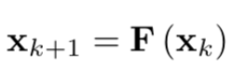
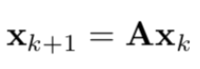
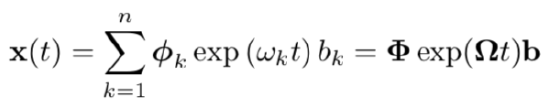
Dynamic Mode Decomposition
The DMD takes the collected measurements as an input
The discrete-time dynamics is considered
If the system is a linear system, it can be represented by linear relationship using the dynamics matrix
The time-domain expression of x(t) can be found if the eigenvalues of A and its eigenvector matrix are known

Slide 11
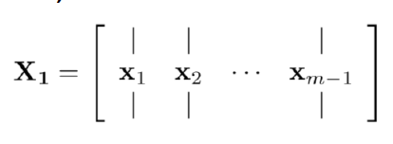
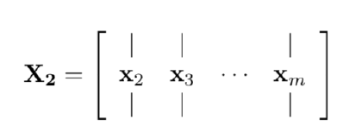
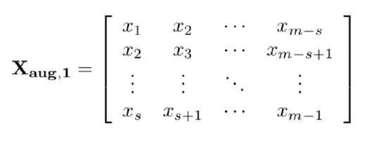
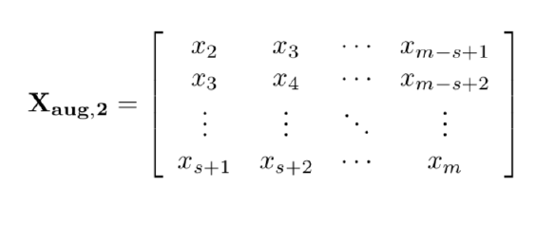
The measurements are set in two matrices, one of them has a time shift, in order that the DMD is enabled to approximate the dynamics matrix, A:
The augmented data matrix form involves both shift-stacking and time-delay

Slide 12
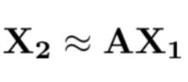
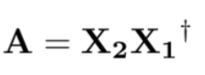
Dynamic Mode Decomposition
Relying on the linear approximation is described in terms of the data measurement matrices
The best-fit dynamics matrix, A, is given by

Slide 13
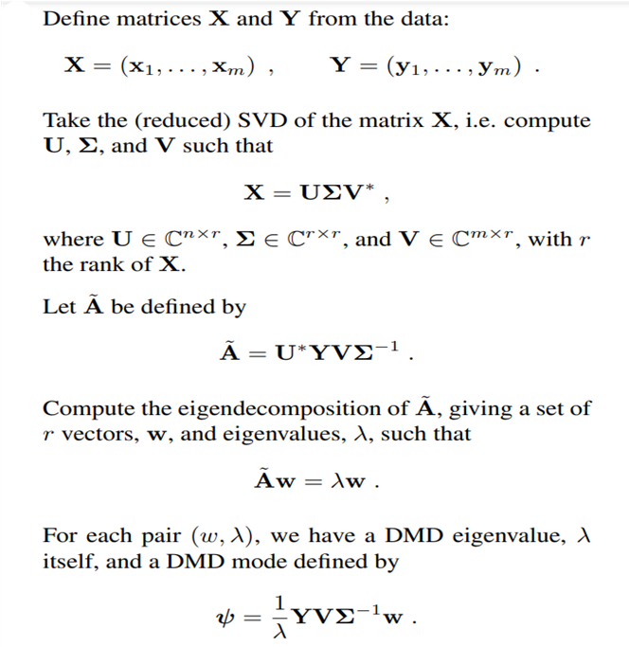
Algorithm

Slide 14
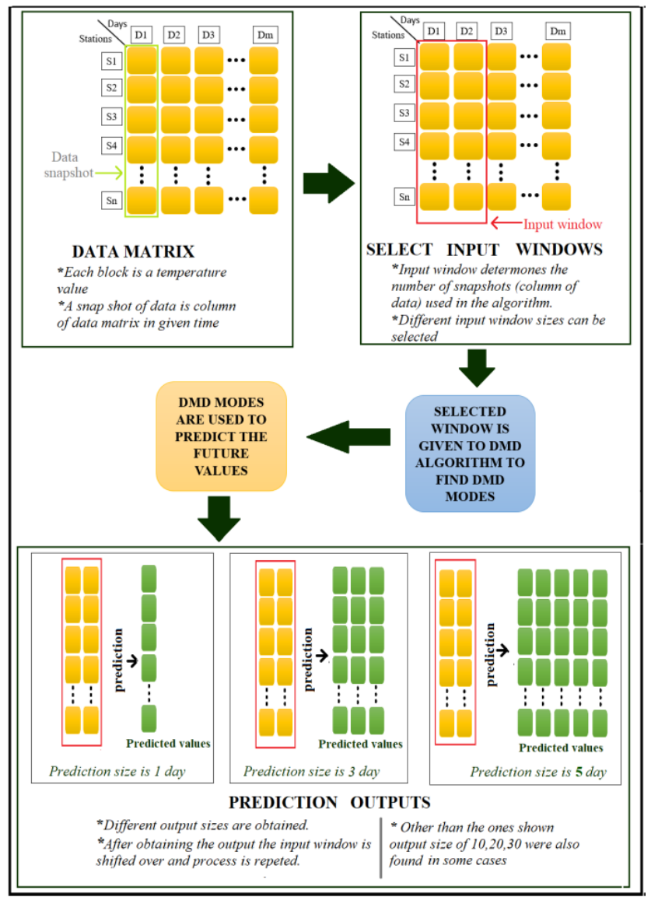
Methodology

Slide 15
Data collection
The first step is to collect temperature time series data. This data can be obtained from weather stations or other sources.

Slide 16
Data preprocessing
The next step is to preprocess the data. This can involve cleaning the data, removing any missing or invalid values, and normalizing the data to a common scale.

Slide 17
DMD analysis
The DMD analysis is then applied to the preprocessed data. This typically involves taking the singular value decomposition (SVD) of the data matrix, and then using the SVD to identify the dominant modes of variability in the data.

Slide 18
Forecast generation
Once the dominant modes of variability have been identified, they can be used to generate forecasts. One common approach is to use the DMD modes as the basis for a linear model, and then use the model to predict future temperature values.

Slide 19
Model evaluation
Finally, the model is evaluated by comparing the forecasted temperature values to the actual temperature values. This can be done using metrics such as mean squared error (MSE) or mean absolute error (MAE).

Slide 20

Results

Slide 21
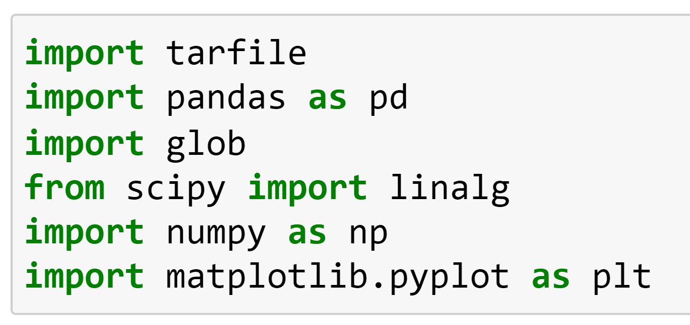
Computation: DMD
Importing Required Libraries

Slide 22
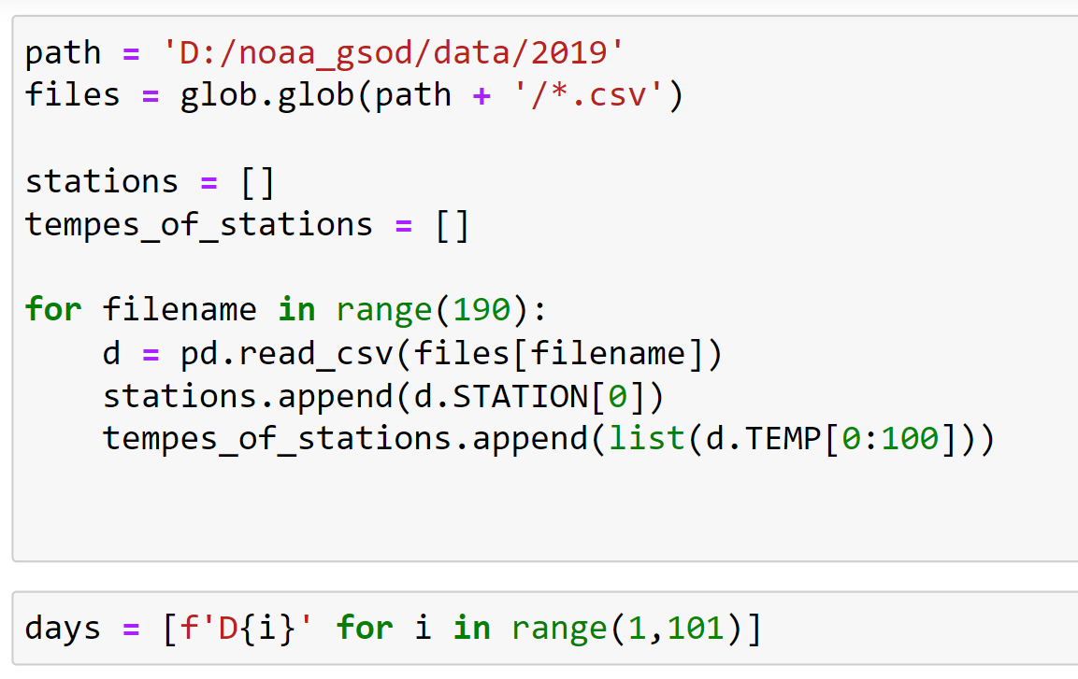
Retrieving Our Data

Slide 23
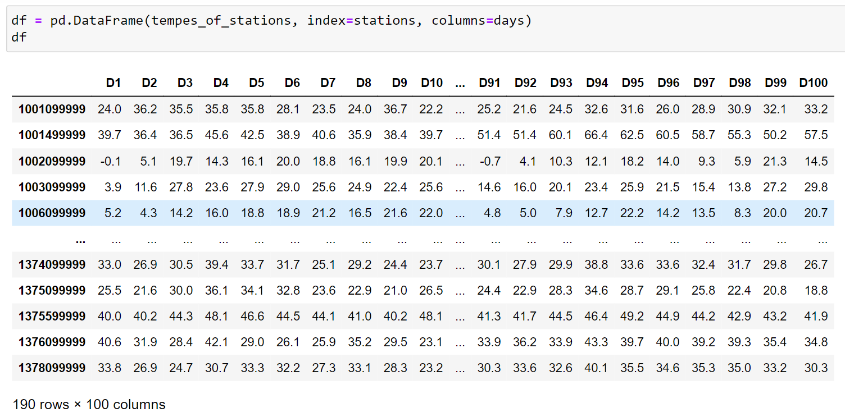
Getting to know our data

Slide 24
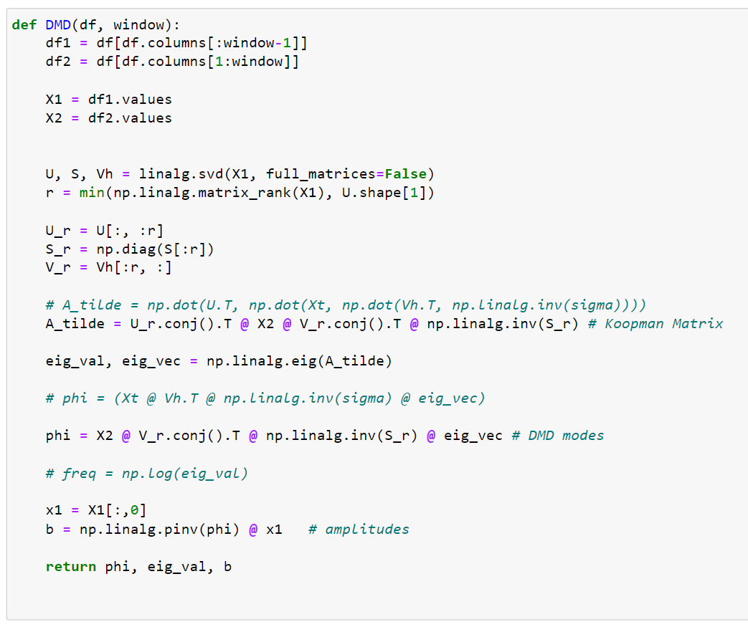
DMD Function

Slide 25
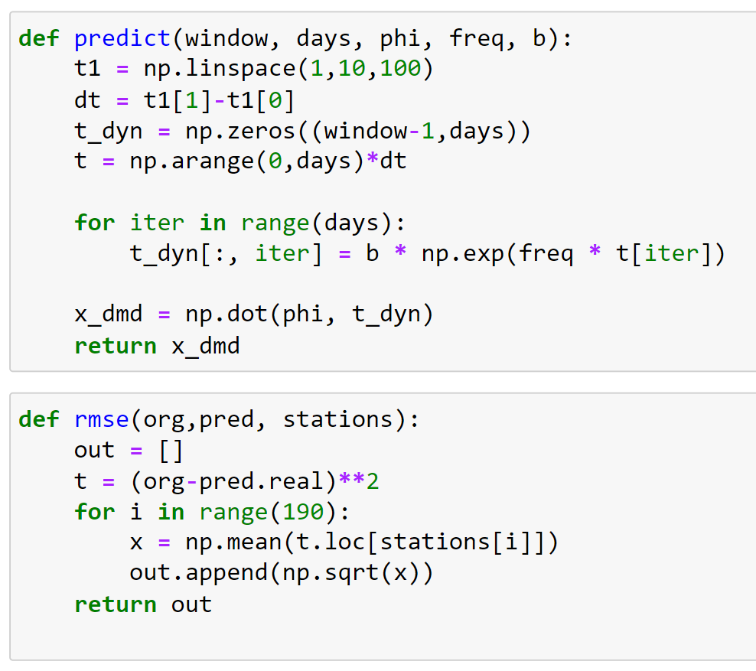
Prediction And RMSE Functions

Slide 26
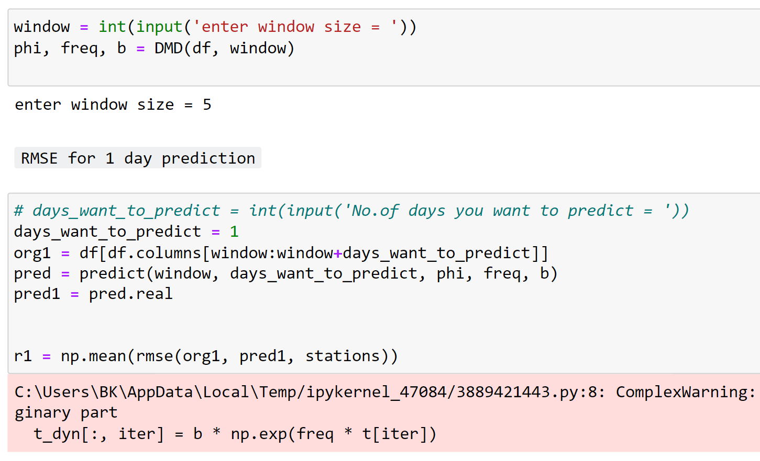
Window Function RMSE for 1 day prediction

Slide 27
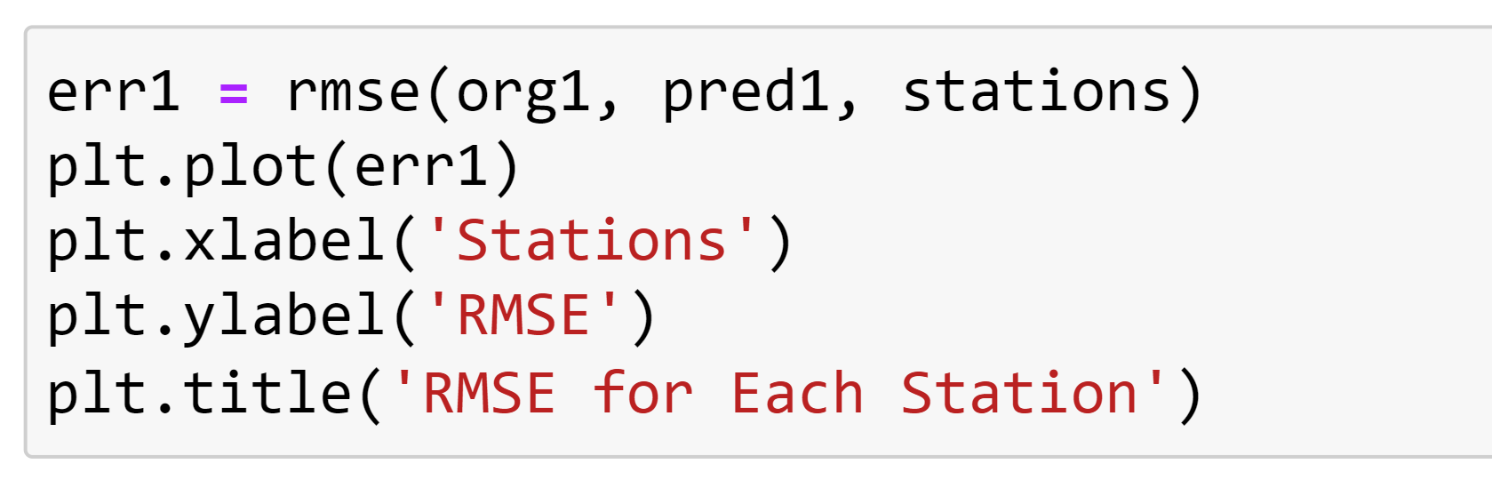
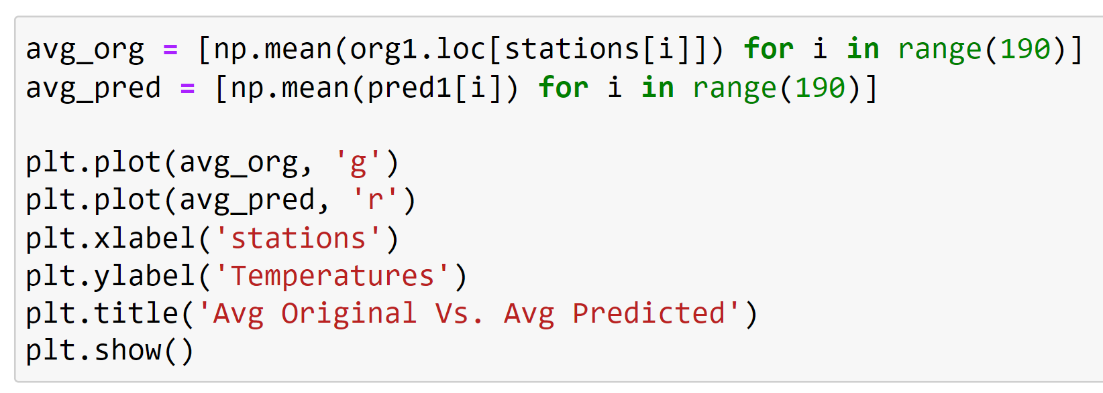

Slide 28
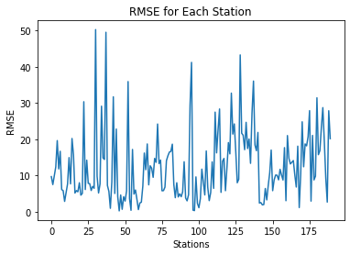
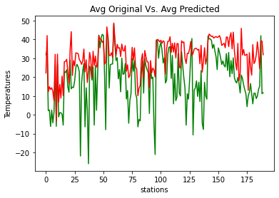
Window size 5
1 Day Prediction

Slide 29
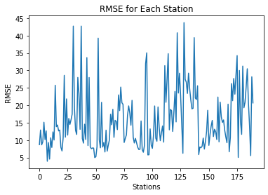
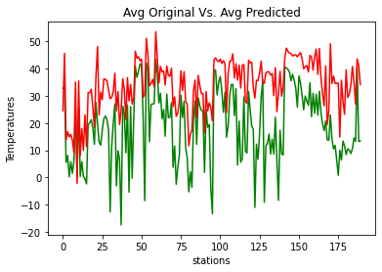
Window size 5
3 Day Prediction

Slide 30
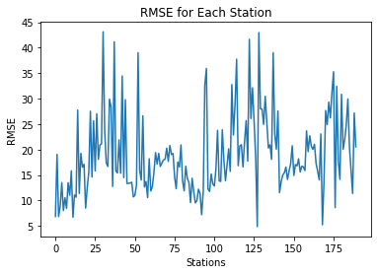
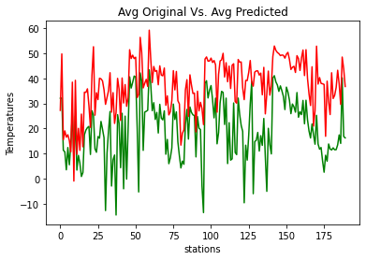
Window size 5
5 Day Prediction

Slide 31
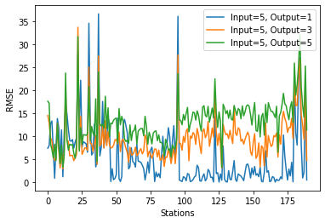
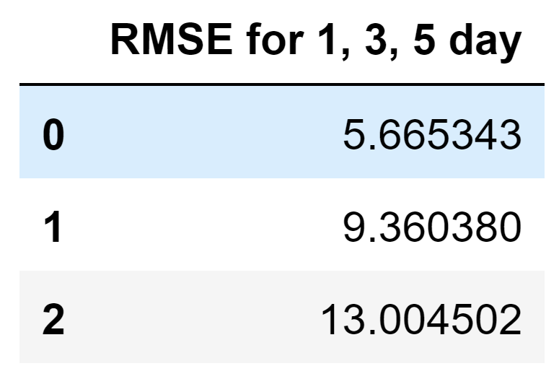
Comparison

Slide 32
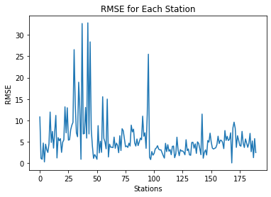
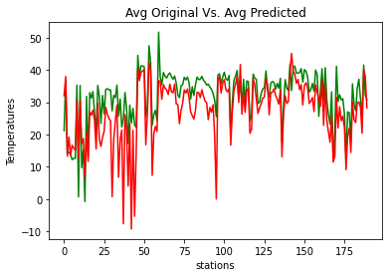
Window size 10
1 Day Prediction

Slide 33
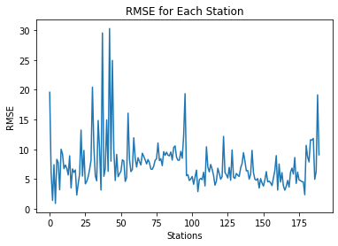
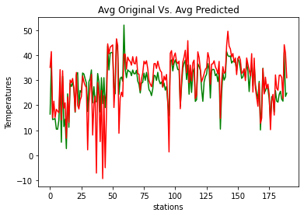
Window size 10
3 Day Prediction

Slide 34
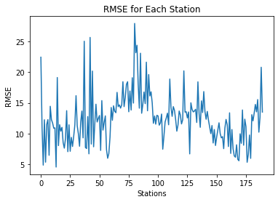
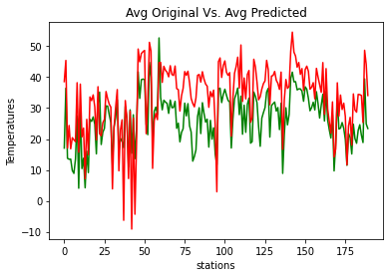
Window size 10
5 Day Prediction

Slide 35
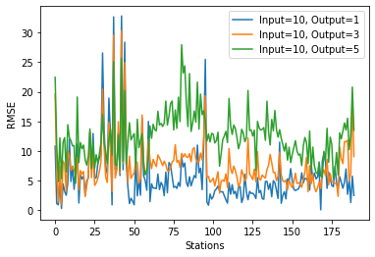
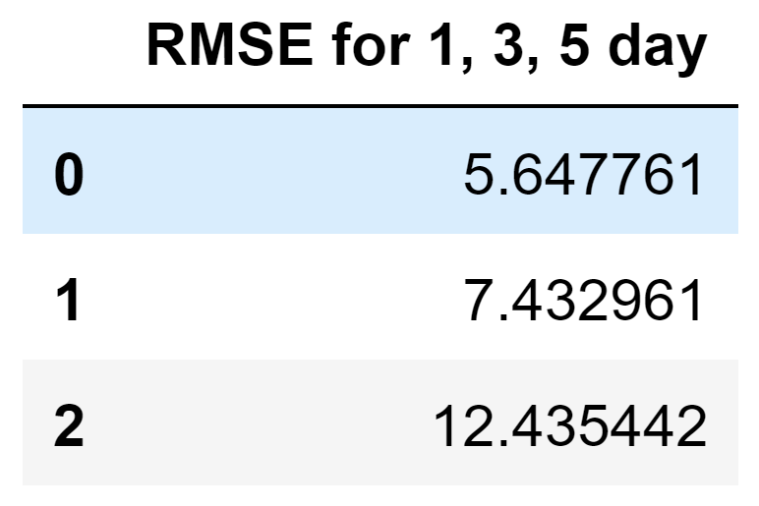
Comparison

Slide 36
Window size 20
1 Day Prediction

Slide 37
Window size 20
3 Day Prediction

Slide 38
Window size 20
5 Day Prediction

Slide 39
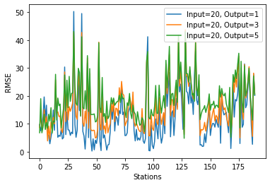
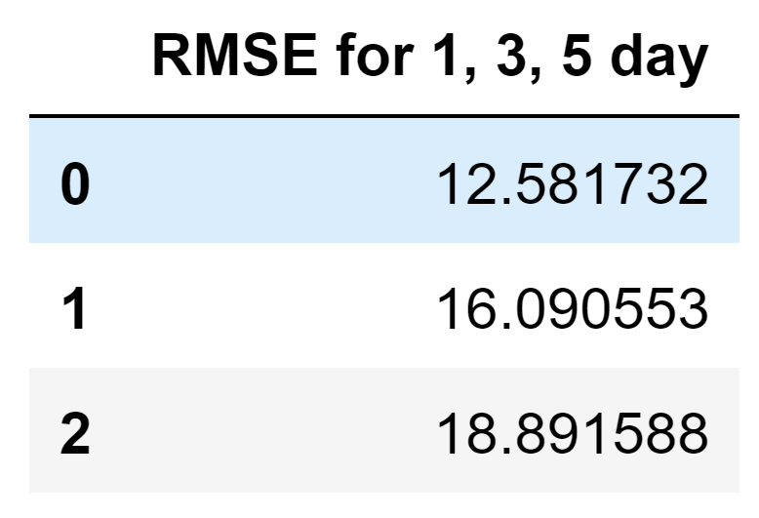
Comparison

Slide 40
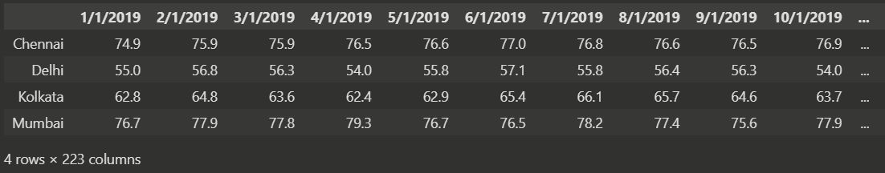
DMD Prediction For India Dataset
These are the temperature data sets of four different cities(Delhi, Mumbai, Kolkata, Chennai) of India starting from 01-01-1995 to 08-11-2019.
Click Here For Dataset

Slide 41
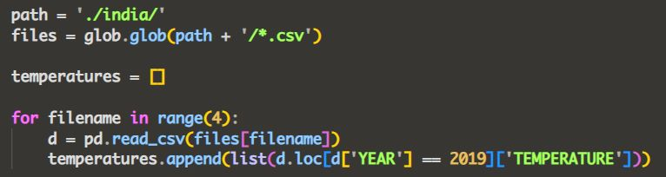
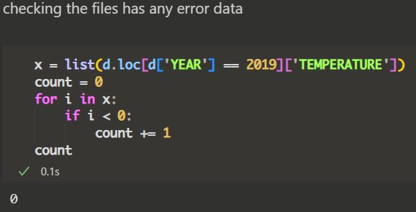
Data Preprocessing

Slide 42
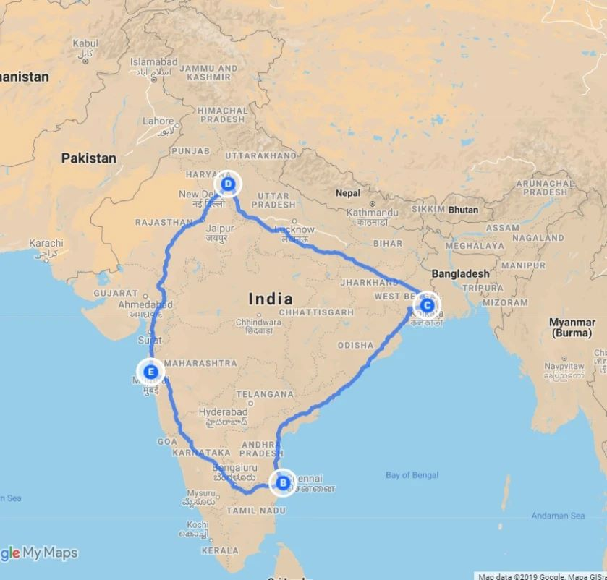
RMSE For 1,3,5 Day Prediction When Input Window is 5
Delhi
2.052
6.321
14.366
Kolkata
2.549
6.077
15.308
Mumbai
0.209
9.200
19.924
Chennai
2.088
8.404
18.303

Slide 43
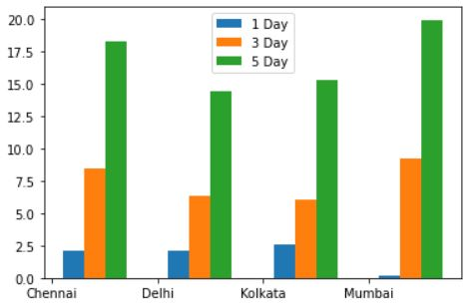
Results

Slide 44
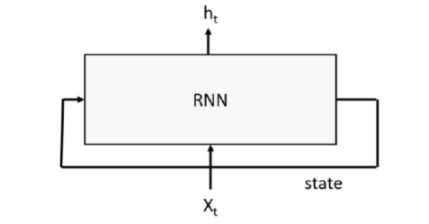
RNNs and Gaussian Processes
RNNs work by having a “memory” state tensor that encodes the sequence of inputs that have been seen so far. The input to the RNN is a word or signal, along with the state of the system based on words or signals seen so far; the output is a predicted value and a new state of the system.

Slide 45
Computation: RNN
We will train it on the average daily temperature over 2 years measured at three weather stations in the Skagit valley in Washington state. The data comes from the Global Summary of the Day (GSOD) weather from the National Oceanographic and Atmospheric Administration (NOAA) for 9,000 weather stations. The three stations are Bellingham Intl, Padilla Bay Reserve, and Skagit Regional.
Building a Very Simple LSTM Recurrent Neural Network

Slide 46
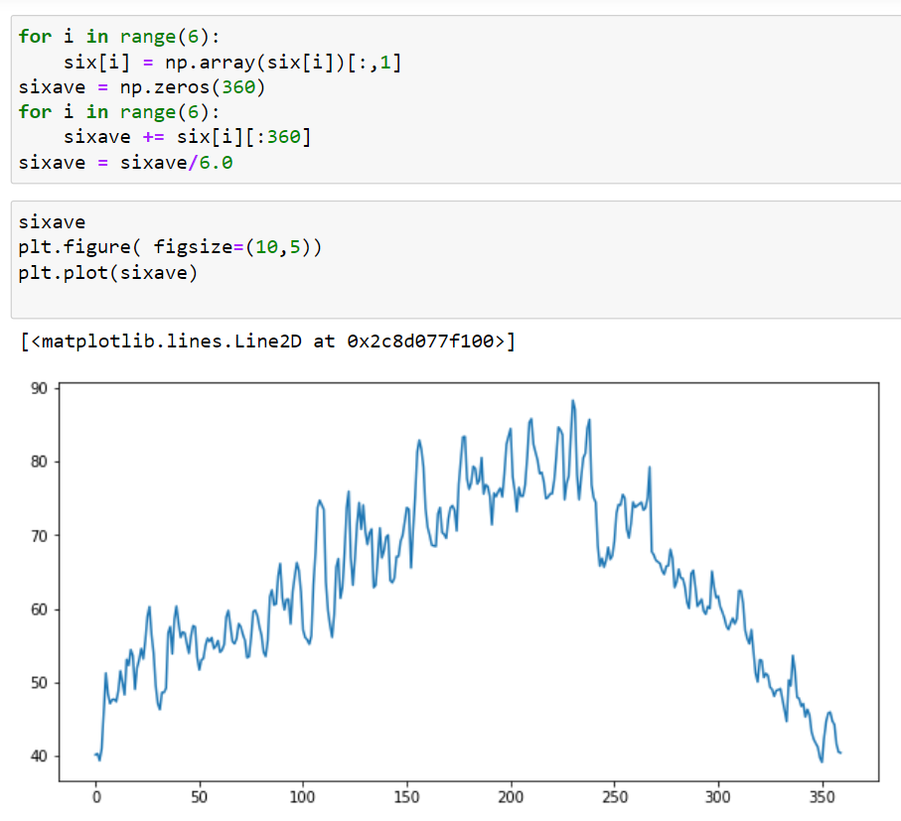
Deploying Our Data
Averaging the daily temperature for 6 years
(2 years each for 3 stations)

Slide 47
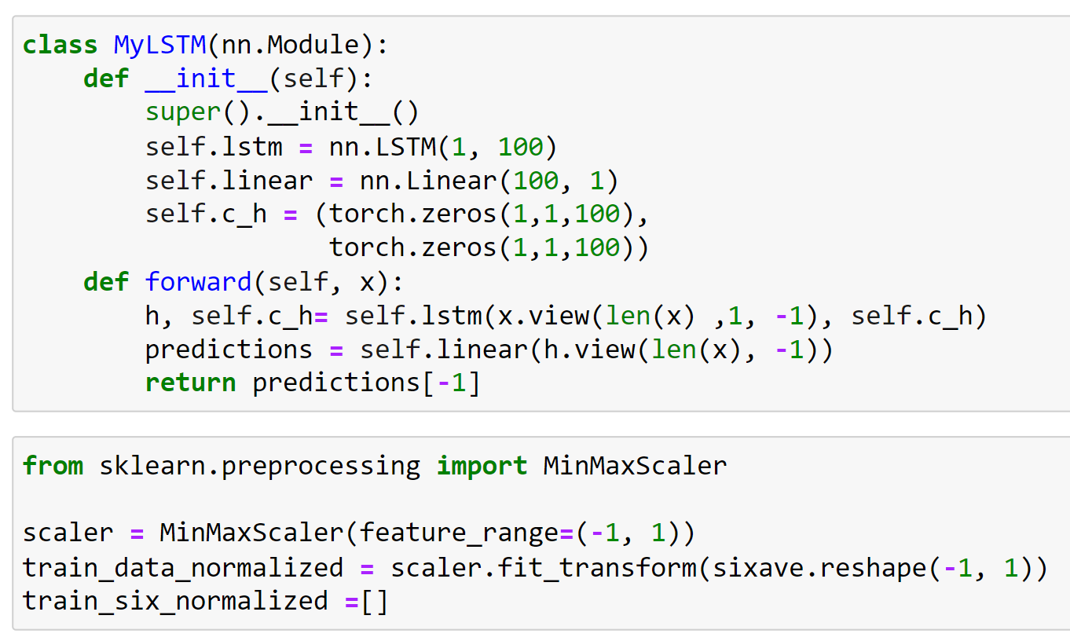
LSTM Function

Slide 48
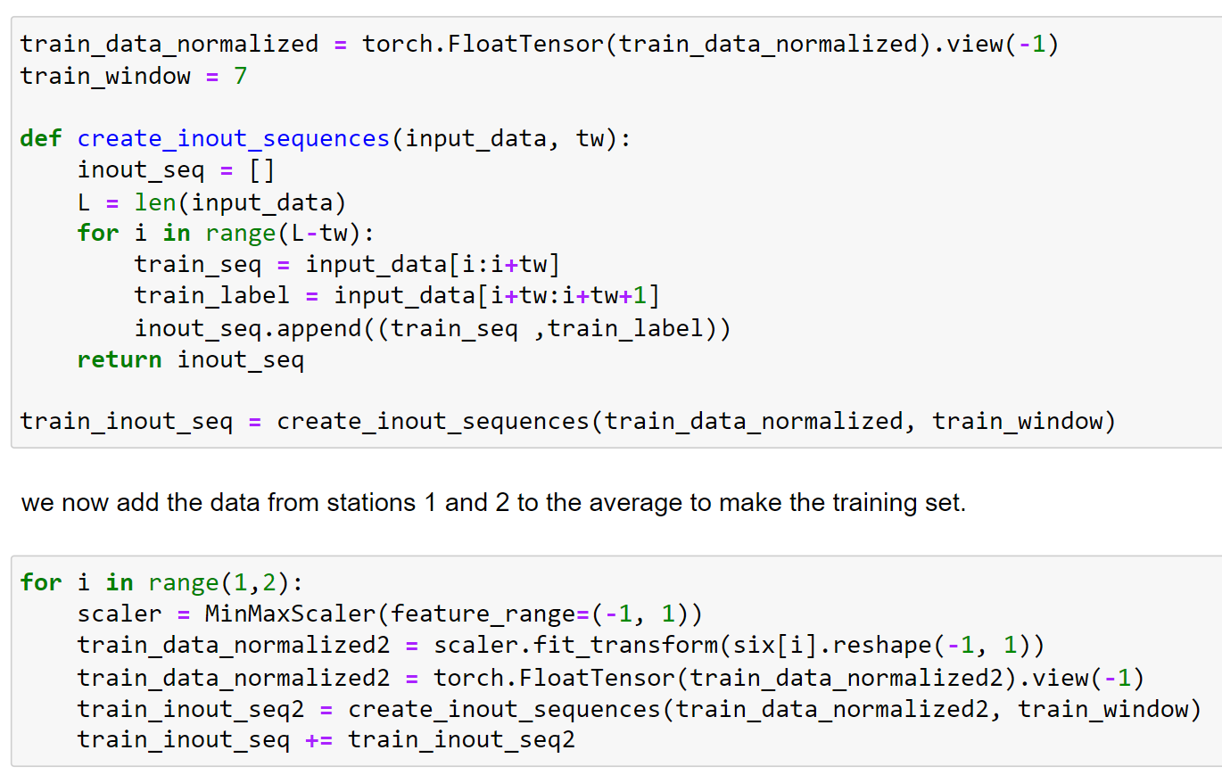
Training the Model

Slide 49

Training the Model
This was trained on the average year and one the six yearly record.

Slide 50

Prediction Phase
The function will take a data set consisting of one year of high-temperature readings and create a sliding window of 12 days and invoke the network to get the 13th day. this predicted 13th day is appended to a list of predictions.

Slide 51

Prediction Phase

Slide 52

Predictions

Slide 53

Predictions

Slide 54

Predictions

Slide 55

Predictions

Slide 56

Predictions

Slide 57

Predictions

Slide 58

Predictions

Slide 59

Conclusion
Dynamic Mode Decomposition (DMD) and machine learning algorithms are both methods that can be used for temperature forecasting. However, there are some key differences between the two methods:

Slide 60
Mathematical foundations
Handling
nonlinearity
and non-stationarity
DMD is based on mathematical techniques from linear algebra and control theory, whereas machine learning algorithms are based on statistical and optimization techniques.
DMD is well-suited for nonlinear and non-stationary systems, which are common in weather and climate data. In contrast, traditional machine learning algorithms may not perform as well on nonlinear and non-stationary data.

Slide 61
Extracting underlying patterns
Complexity of the model
DMD can be used to extract the dominant modes of variability in the data, which can be used to create accurate forecasts. Machine learning algorithms, on the other hand, may not be able to extract the underlying patterns as effectively as DMD.
DMD models are generally simple and interpretable, as they are based on linear dynamics. Machine learning algorithms, on the other hand, can be more complex and harder to interpret.

Slide 62
Data requirements
Flexibility
DMD does not require a large amount of labeled data, whereas machine learning algorithms typically do.
DMD is more specific to time series analysis and it's not as flexible as machine learning algorithms that can be used in various tasks such as classification and regression.

Slide 63
Thank You

